Slide 1
Sales and Operations Planning (Aggregate Planning)
Sales and Operations Planning:
An aggregate planning process
Determines the resource capacity of a firm needed to meet its demand
Time horizon – intermediate (eg: months)
During this time frame, the capacity expansion (through facility expansion) is not feasible
Managing the demand
Managing the supply

Slide 2
Aggregate Planning
Managing the supply
Feasible courses of action to meet the fluctuating demand during the intermediate time frame:
Hiring and laying-off of workers
Overtime work
Subcontracting
Backordering
Increase the number of standard work hours

Slide 3
Aggregate Planning
Managing the demand
Feasible courses of action to influence the demand
Pricing
Promotions

Slide 4
Aggregate planning
Strategies to adjust capacity to meet fluctuating demand
Pure strategy
Level: Constant production plan
Chase: Zero inventory plan
Mixed strategy
Combination of pure strategies, incorporating additional constraints of production process

Slide 5
Pure Strategy
Production
Level strategy
Units
Demand
Time
Chase strategy
Units
Production
Time

Slide 6
Push and Pull Production Systems
Push versus pull: two fundamental philosophies for movement of materials in a production system
Push system: production planning is done for all levels in advance. Once production is completed, units are pushed to the next level
Pull system: items are moved from one level to the next only when requested

Slide 7
Push and Pull Production Systems
Push system:
Material requirements planning (MRP) , MRP II, ERP
Based on forecasts for end items over a specified planning horizon, the MRP planning system determines production quantities for each level of the system
Pull system:
Just-in-time (JIT), lean production, CONWIP
Fundamental goal is to reduce work-in-process to a bare minimum
Items are only moved when requested by the next higher level in the production process

Slide 8
Material Requirements Planning (MRP)
The MRP explosion calculus is a set of rules for converting a master production schedule (MPS) to a build schedule for all the components comprising the end product.
The MPS is a production plan for the end item or final product by period
MPS states which end items are to be produced, when these are needed, and in what quantities
At each stage in the process, one computes the production amounts required at each level of the production process

Slide 9
Scheduling & Sequencing
Scheduling: Establishing the timing of the use of equipment, facilities, and human activities in an organization
Effective scheduling can yield
Cost savings
Increase in productivity
Sequencing: Determine the order in which jobs at a work center will be processed
Priority rules
Simple heuristics, used to select the order in which jobs will be processed

Slide 10
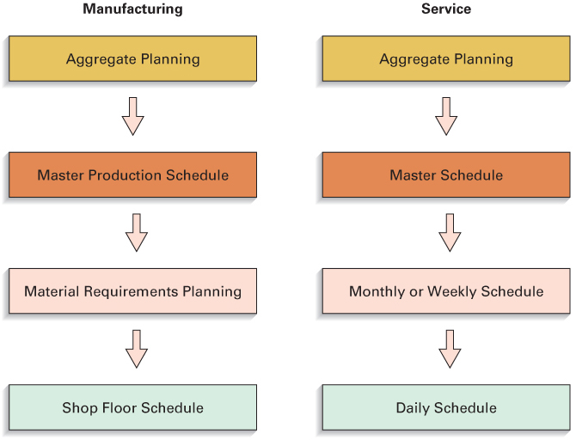
Scheduling Hierarchies

Slide 11
Scheduling the Service
Service scheduling often presents challenges not found in manufacturing
These are primarily related to:
The inability to store or inventory services
The random nature of service requests
Service scheduling may involve scheduling:
Customers
Workforce

Slide 12
Scheduling Service Operations
Scheduling customers: Demand management
Appointment systems
Controls customer arrivals for service
Reservation systems
Enable service systems to formulate a fairly accurate estimate of demand on the system for a given time period
Scheduling the workforce: Capacity management
Cyclical Scheduling
Employees are assigned to work shifts or time slots and have days off on a repeating basis

